Slide 1
Computer Science II Advanced C++
Spring 2019

Slide 2
Structured data
Combining data into structures

Slide 3
Useful Link to C++ tutorial
There are some useful hints and illustrations on structured data in C++ at
http://www.cplusplus.com/doc/tutorial/structures/

Slide 4
Abstract Data Types
A data type that specifies
values that can be stored
operations that can be done on the values
User of an abstract data type does not need to know the implementation of the data type, e.g., how the data is stored
ADTs are created by programmers

Slide 5
Abstraction and Data Types
Abstraction: a definition that captures general characteristics without details
Ex: An abstract triangle is a 3-sided polygon. A specific triangle may be scalene, isosceles, or equilateral
Data Type defines the values that can be stored in a variable and the operations that can be performed on it

Slide 6
Structured data in C++
A structure is a group of data elements grouped together under one name. These data elements, known as members, can have different types and different lengths.
Structures can be declared in C++ using the following syntax:
struct <structName>
{
type1 field1;
type2 field2;
. . .
};

Slide 7
Example struct Declaration
struct Student
{
int studentID;
string name;
short yearInSchool;
double gpa;
};
structure tag
structure members

Slide 8
struct Declaration Notes
Must have ; after closing }
struct names commonly begin with uppercase letter
Multiple fields of same type can be in comma-separated list:
string name,
address;

Slide 9
Defining Variables
struct declaration does not allocate memory or create variables
To define variables, use structure tag as type name:
Student bill;
bill
studentID
name
yearInSchool
gpa

Slide 10
Example
struct Product {
int weight;
double price;
} apple, banana, melon;
This declares a structure type, called Product, and defines it having two members: weight and price, each of a different fundamental type. This declaration creates a new type (Product), which is then used to declare three instances (variables) of this type: apple, banana, and melon. Note how once Product is declared, it is used just like any other type
It is important to clearly differentiate between what is the structure type name (Product), and what is an instance of this type (apple, banana, and melon). Many instances (such as apple, banana, and melon) can be declared from a single structure type (Product)

Slide 11
Example 1
struct Product {
int weight;
double price;
} apple, banana, melon;
When instance_names are specified, the structName (Product) becomes optional: struct requires either a structure name or at least one instance, but not necessarily both It is important to clearly differentiate between what is the structure type name (Product), and what is an instance of this type (apple, banana, and melon). Many instances (such as apple, banana, and melon) can be declared from a single structure type (Product)

Slide 12
Accessing Structure Members
Use the dot (.) operator to refer to members of struct variables:
cin >> stu1.studentID;
getline(cin, stu1.name);
stu1.gpa = 3.75;
Member variables can be used in any manner appropriate for their data type

Slide 13
Example 2
struct Product {
int weight;
double price;
};
Product apple, banana, melon;
apple.weight = 1;
apple.price = 1.49;
banana.weight = 1;
banana.price = 0.49;
melon.weight = 1;
melon.price = 0.39;

Slide 14
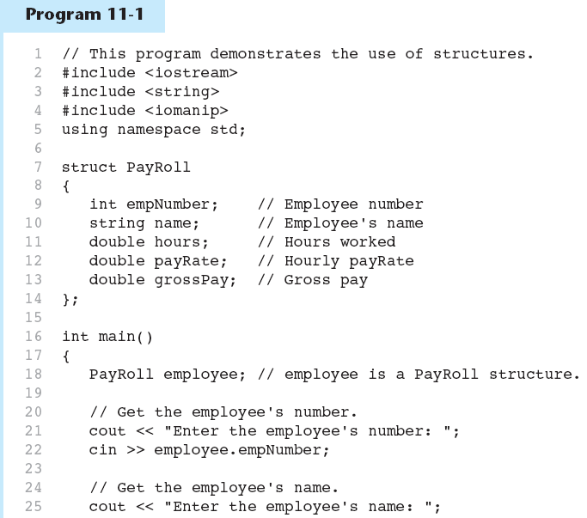

Slide 15
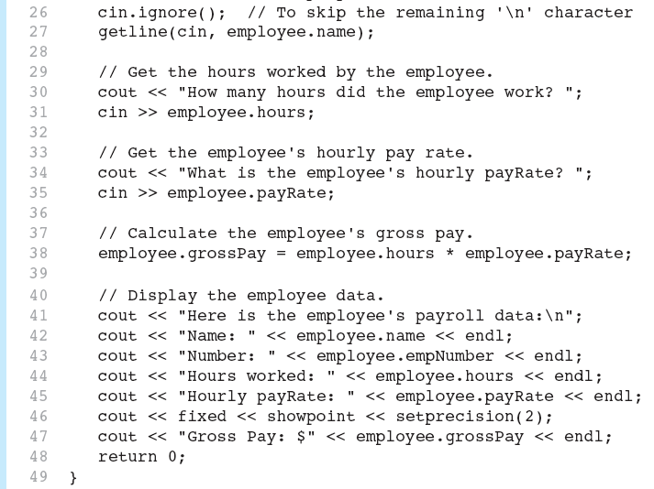

Slide 16
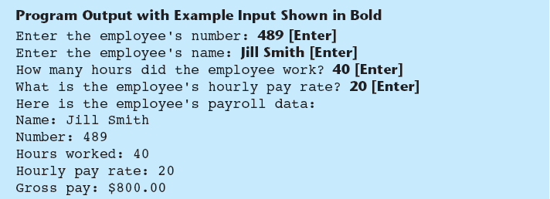

Slide 17
Displaying a struct Variable
To display the contents of a struct variable, must display each field separately, using the dot operator:
cout << bill; // won’t work
cout << bill.studentID << endl;
cout << bill.name << endl;
cout << bill.yearInSchool;
cout << " " << bill.gpa;

Slide 18
Comparing struct Variables
Cannot compare struct variables directly:
if (bill == william) // won’t work
Instead, must compare on a field basis:
if (bill.studentID ==
william.studentID) ...

Slide 19
Example 3 – struct movie
Let us consider the following structure
Movie
string title;
int year;

Slide 20
Example 3 (cont)
int main()
{
string mystr; // "buffer" string for input
// assignment of title to mine
mine.title = ”The shawshank Redemption";
// assignment of year to mine
mine.year = 1994;
// prompt the user to enter title of yours
cout << "Enter title: ";
// enter yours title
getline(cin, yours.title);
// prompt the user to enter year for yours
cout << "Enter year: ";
// enter yours year as a mystr string
getline(cin, mystr);
// convert mystr into the number
stringstream(mystr) >> yours.year;
// print out the content of mine
cout << "My favorite movie is:\n "; printmovie(mine);
// print out the content // of yours
cout << "And yours is:\n ";
printmovie(yours);
return 0;
}
#include <iostream>
#include <string>
#include <sstream> // a library for working with strings i/o streams
using namespace std;
struct movie { // definition of the movie structure
string title; // movie title
int year; // movie year
} mine, yours; // def. the mine and yours instances of the movie type
void printmovie(movie movieObject); // function printmovie prototype
// definition of the printmovie function
void printmovie(movie movieObject)
{
cout << movieObject.title; // print title
cout << " (" << movieObject.year << ")" << endl << endl; // print year
}

Slide 21
Initializing a Structure
struct variable can be initialized when defined:
Student s = {11465, "Joan", 2, 3.75};
Can also be initialized member-by-member after definition:
s.name = "Joan";
s.gpa = 3.75;

Slide 22
More on Initializing a Structure
May initialize only some members:
Student bill = {14579};
Cannot skip over members:
Student s = {1234, "John", ,
2.83}; // illegal
Cannot initialize in the structure declaration, since this does not allocate memory

Slide 23
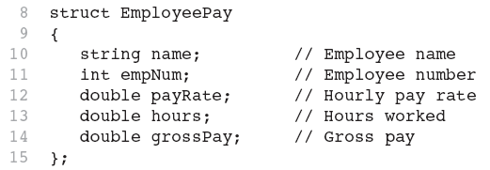
Excerpts From Program 11-3

Slide 24
Arrays of Structures
Structures can be defined in arrays
Can be used in place of parallel arrays const int NUM_STUDENTS = 20; Student stuList[NUM_STUDENTS];
Individual structures accessible using subscript notation
Fields within structures accessible using dot notation:
cout << stuList[5].studentID;

Slide 25
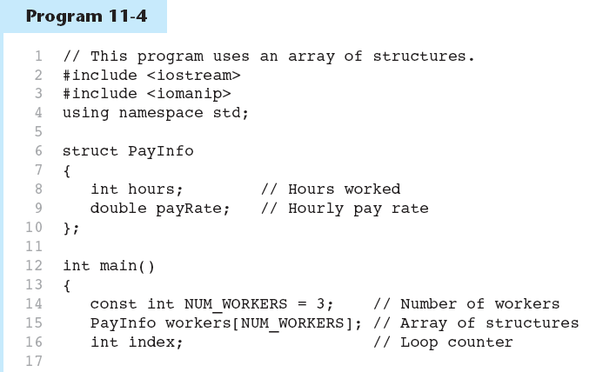

Slide 26
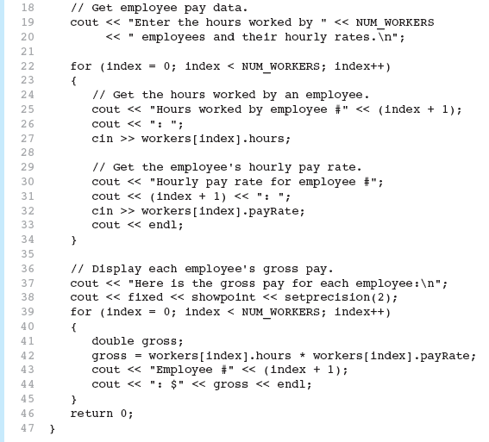

Slide 27
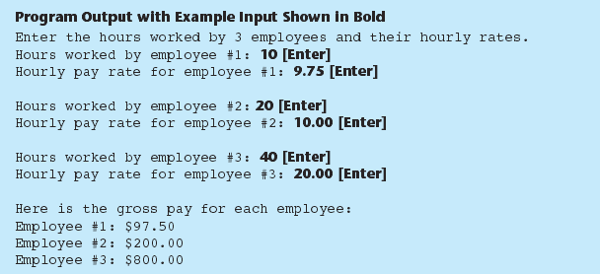

Slide 28
Nested Structures
A structure can contain another structure as a member:
struct PersonInfo
{ string name,
address,
city;
};
struct Student
{ int studentID;
PersonInfo pData;
short yearInSchool;
double gpa;
};

Slide 29
Members of Nested Structures
Use the dot operator multiple times to refer to fields of nested structures:
Student s;
s.pData.name = "Joanne";
s.pData.city = "Tulsa";

Slide 30
Structures as Function Arguments
May pass members of struct variables to functions:
computeGPA(stu.gpa);
May pass entire struct variables to functions:
showData(stu);
Can use reference parameter if function needs to modify contents of a structure variable

Slide 31
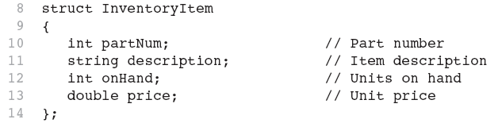
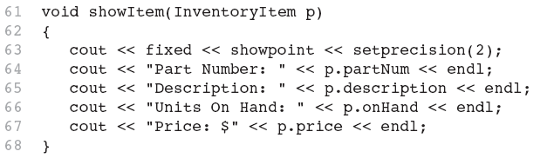
Excerpts from Program 11-6

Slide 32
Structures as Function Arguments - Notes
Using value parameter for structure can slow down a program, waste space
Using a reference parameter will speed up program, but function may change data in structure
Using a const reference parameter allows read-only access to reference parameter, does not waste space, speed

Slide 33
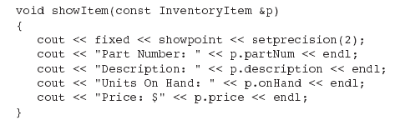
Revised showItem Function

Slide 34
Returning a Structure from a Function
Function can return a struct:
Student getStudentData(); // prototype
stu1 = getStudentData(); // call
Function must define a local structure
for internal use
for use with return statement

Slide 35
Returning a Structure from a Function - Example
Student getStudentData() // function definition
{ Student tempStu;
cin >> tempStu.studentID;
getline(cin, tempStu.pData.name);
getline(cin, tempStu.pData.address);
getline(cin, tempStu.pData.city);
cin >> tempStu.yearInSchool;
cin >> tempStu.gpa;
return tempStu;
}

Slide 36
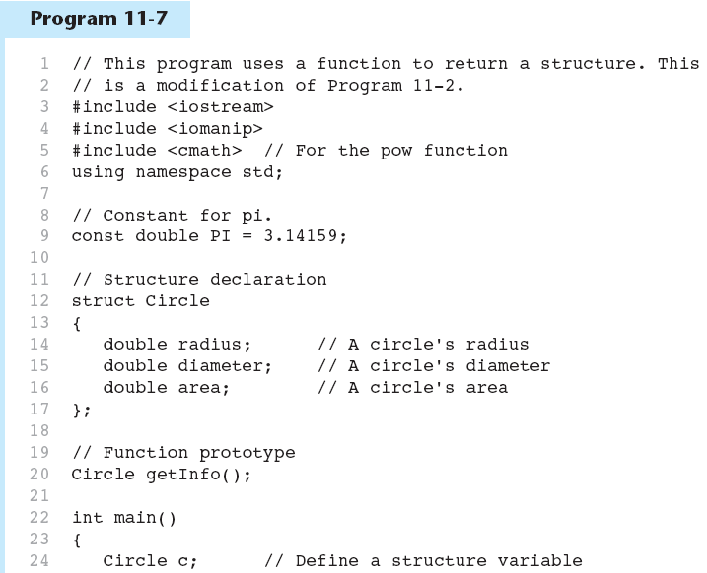

Slide 37
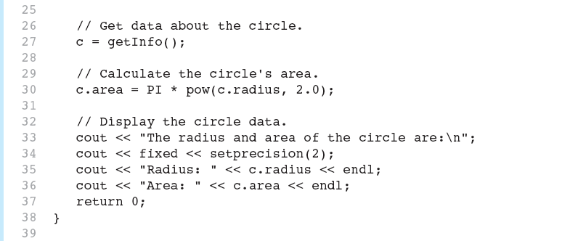

Slide 38
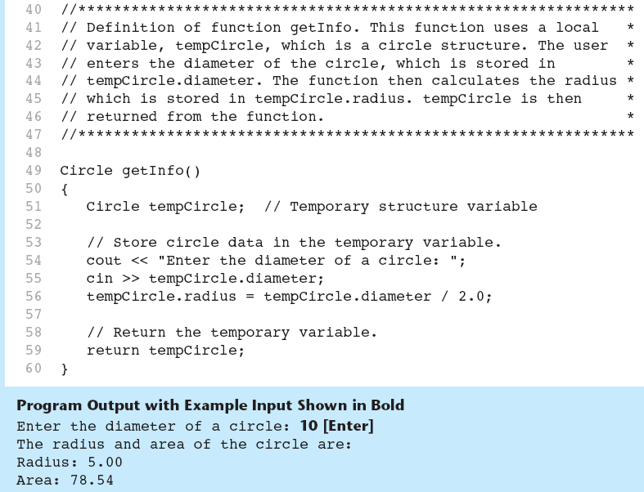

Slide 39
11.9
Pointers to Structures

Slide 40
Pointers to Structures
A structure variable has an address
Pointers to structures are variables that can hold the address of a structure:
Student *stuPtr; // can hold the //address of Student structure
Can use & operator to assign address:
Student stu1; // definition of stu1
stuPtr = &stu1; //addr of stu1->stuPtr
Structure pointer can be a function parameter

Slide 41
Accessing Structure Members via Pointer Variables
Must use () to dereference pointer variable, not field within structure:
cout << (*stuPtr).studentID;
Can use structure pointer operator -> to eliminate () and use clearer notation:
cout << stuPtr->studentID;

Slide 42
Accessing Structure Members via Pointer Variables
Expression | What is evaluated | Equivalent
a.b | Member b of object a
a->b | Member b of object pointed to by a | (*a).b
*a.b | Value pointed to by member b of object a | *(a.b)

Slide 43
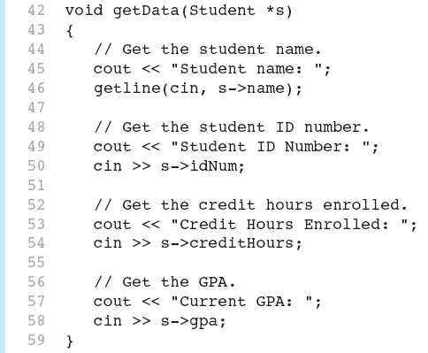
From Program 11-8

Slide 44
11.11
Unions

Slide 45
Unions
Similar to a struct, but
all members share a single memory location, and
only one member of the union can be used at a time
Declared using union, otherwise the same as struct
Variables defined as for struct variables

Slide 46
Anonymous Union
A union without a union tag:
union { ... };
Must use static if declared outside of a function
Allocates memory at declaration time
Can refer to members directly without dot operator
Uses only one memory location, saves space

Slide 47
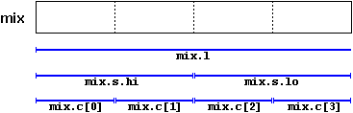
Where it convenient to use union
One of the uses of a union is to be able to access a value either in its entirety or as an array or structure of smaller elements. For example:
union mix_t
{
int l;
struct
{
short hi;
short lo;
} s;
char c[4];
} mix;

Slide 48
Where it convenient to use union
If we assume that the system where this program runs has an int type with a size of 4 bytes, and a short type of 2 bytes, the union defined above allows the access to the same group of 4 bytes: mix.l, mix.s and mix.c,
and which we can use according to how we want to access these bytes: as if they were a single value of type int, or as if they were two values of type short, or as an array of char elements, respectively.
union mix_t
{
int l;
struct
{
short hi;
short lo;
} s;
char c[4];
} mix;

Slide 49
11.12
Enumerated Data Types

Slide 50
Enumerated Data Types
An enumerated data type is a programmer-defined data type.
It consists of values known as enumerators, which represent integer constants.

Slide 51
Enumerated Data Types
Example: enum Day { MONDAY, TUESDAY, WEDNESDAY, THURSDAY, FRIDAY };
The identifiers MONDAY, TUESDAY, WEDNESDAY, THURSDAY, and FRIDAY, which are listed inside the braces, are enumerators. They represent the values that belong to the Day data type.

Slide 52
Enumerated Data Types
enum Day{ MONDAY, TUESDAY, WEDNESDAY, THURSDAY, FRIDAY };
Note that the enumerators are not strings, so they aren’t enclosed in quotes. They are identifiers.

Slide 53
Enumerated Data Types
Once you have created an enumerated data type in your program, you can define variables of that type. Example: Day workDay;
This statement defines workDay as a variable of the Day type.

Slide 54
Enumerated Data Types
We may assign any of the enumerators MONDAY, TUESDAY, WEDNESDAY, THURSDAY, or FRIDAY to a variable of the Day type. Example: workDay = WEDNESDAY;

Slide 55
Enumerated Data Types
So, what is an enumerator?
Think of it as an integer named constant
Internally, the compiler assigns integer values to the enumerators, beginning at 0.

Slide 56
Enumerated Data Types
enum Day { MONDAY, TUESDAY, WEDNESDAY, THURSDAY, FRIDAY };
In memory...
MONDAY = 0 TUESDAY = 1 WEDNESDAY = 2 THURSDAY = 3 FRIDAY = 4

Slide 57
Enumerated Data Types
Using the Day declaration, the following code... cout << MONDAY << " " << WEDNESDAY << " “ << FRIDAY << endl; ...will produce this output: 0 2 4

Slide 58
Assigning an integer to an enum Variable
You cannot directly assign an integer value to an enum variable. This will not work: workDay = 3; // Error!
Instead, you must cast the integer: workDay = static_cast<Day>(3);

Slide 59
Assigning an Enumerator to an int Variable
You CAN assign an enumerator to an int variable. For example: int x; x = THURSDAY;
This code assigns 3 to x.

Slide 60
Comparing Enumerator Values
Enumerator values can be compared using the relational operators. For example, using the Day data type the following code will display the message "Friday is greater than Monday.“ if (FRIDAY > MONDAY) { cout << "Friday is greater " << "than Monday.\n"; }

Slide 61
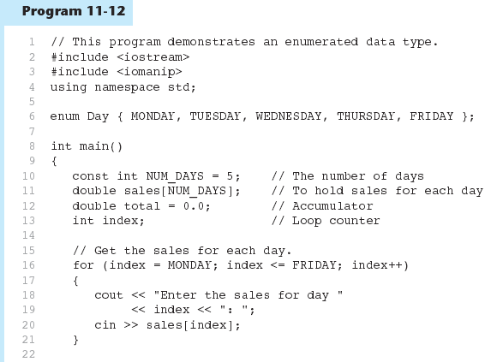

Slide 62
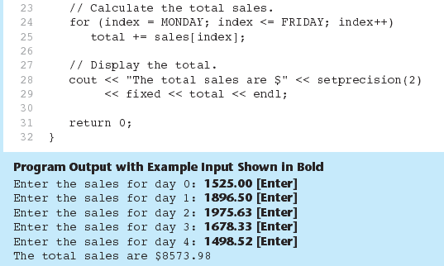
Program 11-12 (Continued)

Slide 63
Enumerated Data Types
Program 11-12 shows enumerators used to control a loop: // Get the sales for each day. for (index = MONDAY; index <= FRIDAY; index++) { cout << "Enter the sales for day " << index << ": "; cin >> sales[index]; }

Slide 64
Anonymous Enumerated Types
An anonymous enumerated type is simply one that does not have a name. For example, in Program 11-13 we could have declared the enumerated type as: enum { MONDAY, TUESDAY, WEDNESDAY, THURSDAY, FRIDAY };

Slide 65
Using Math Operators with enum Variables
You can run into problems when trying to perform math operations with enum variables. For example: Day day1, day2; // Define two Day variables. day1 = TUESDAY; // Assign TUESDAY to day1. day2 = day1 + 1;// ERROR! Will not work!
The third statement will not work because the expression day1 + 1 results in the integer value 2, and you cannot store an int in an enum variable.

Slide 66
Using Math Operators with enum Variables
You can fix this by using a cast to explicitly convert the result to Day, as shown here: // This will work day2 = static_cast<Day>(day1 + 1);

Slide 67
Using an enum Variable to Step through an Array's Elements
Because enumerators are stored in memory as integers, you can use them as array subscripts. For example:
enum Day { MONDAY, TUESDAY, WEDNESDAY,
THURSDAY, FRIDAY };
const int NUM_DAYS = 5;
double sales[NUM_DAYS];
sales[MONDAY] = 1525.0;
sales[TUESDAY] = 1896.5;
sales[WEDNESDAY] = 1975.63;
sales[THURSDAY] = 1678.33;
sales[FRIDAY] = 1498.52;

Slide 68
Using an enum Variable to Step through an Array's Elements
Remember, though, you cannot use the ++ operator on an enum variable. So, the following loop will NOT work.
Day workDay; // Define a Day variable
// ERROR!!! This code will NOT work!
for (workDay = MONDAY; workDay <= FRIDAY; workDay++)
{
cout << "Enter the sales for day "
<< workDay << ": ";
cin >> sales[workDay];
}

Slide 69
Using an enum Variable to Step through an Array's Elements
You must rewrite the loop’s update expression using a cast instead of ++:
for (workDay = MONDAY; workDay <= FRIDAY;
workDay = static_cast<Day>(workDay + 1))
{
cout << "Enter the sales for day "
<< workDay << ": ";
cin >> sales[workDay];
}

Slide 70
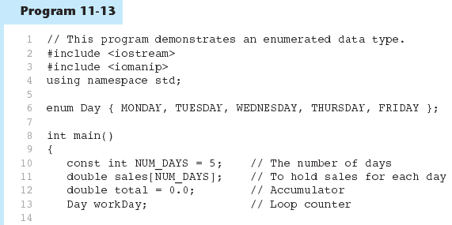

Slide 71
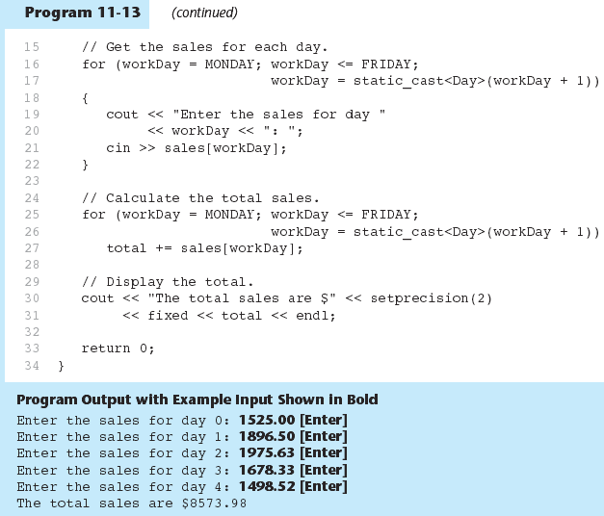

Slide 72
Enumerators Must Be Unique Within the same Scope
Enumerators must be unique within the same scope. (Unless strongly typed)
For example, an error will result if both of the following enumerated types are declared within the same scope:
enum Presidents { MCKINLEY, ROOSEVELT, TAFT };
enum VicePresidents { ROOSEVELT, FAIRBANKS,
SHERMAN };
ROOSEVELT is declared twice.

Slide 73
Using Strongly Typed enums in C++ 11
In C++ 11, you can use a new type of enum , known as a strongly typed enum
Allows you to have multiple enumerators in the same scope with the same name
Prefix the enumerator with the name of the enum , followed by the :: operator:
Use a cast operator to retrieve integer value:
enum class Presidents { MCKINLEY, ROOSEVELT, TAFT };
enum class VicePresidents { ROOSEVELT, FAIRBANKS, SHERMAN };
Presidents prez = Presidents::ROOSEVELT;
VicePresidents vp = VicePresidents::ROOSEVELT;
int x = static_cast<int>(Presidents::ROOSEVELT);

Slide 74
Declaring the Type and Defining the Variables in One Statement
You can declare an enumerated data type and define one or more variables of the type in the same statement. For example:
enum Car { PORSCHE, FERRARI, JAGUAR } sportsCar;
This code declares the Car data type and defines a variable named sportsCar.

